Slide 1
Function Details
W. Clements
CSE 111 Program with Functions

Slide 2
Overview
Prepare: Reading, Video
Checkpoint
Teach: Class Activity
Prove: Milestone
Ponder: Check your understanding

Slide 3
Review
Input
Process
Output
A function is a group of statements that together perform one task. A user-defined function is a function written by a programmer like you. To write a user-defined function, write code that follows this template:
To call a user-defined function, write code that follows this template:
def function_name(param1, param2, … paramN):
"""documentation string"""
statement1
statement2
⋮
statementN
return value
variable_name = function_name(arg1, arg2, … argN)

Slide 4
04 Prepare: Function Details
Overview
Concepts
During this lesson, you will learn additional details about writing and calling functions. These details include variable scope, default parameter values, and optional arguments and will help you understand functions better and write them more effectively.
Review
02 Prepare: Calling Functions: Arguments
03 Prepare: Writing Functions: Parameters
Variable Scope¶
Common Mistake¶
Default Parameter Values and Optional Arguments
Function Design¶
https://byui-cse.github.io/cse111-course/lesson04/prepare.html

Slide 5
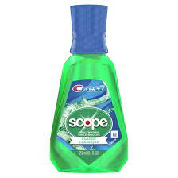
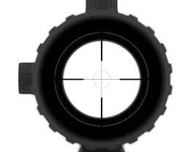

Variable Scope¶

Slide 6
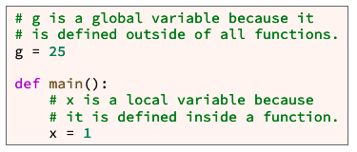
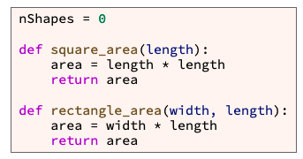
Variable Scope¶
Life of a variable
C: Where is it created?
R: When is it read?
U: When is it updated?
D: When is it deleted?
C: Where is it created?
U: When is it updated?
R: When is it read?
D: When is it deleted?

Slide 7
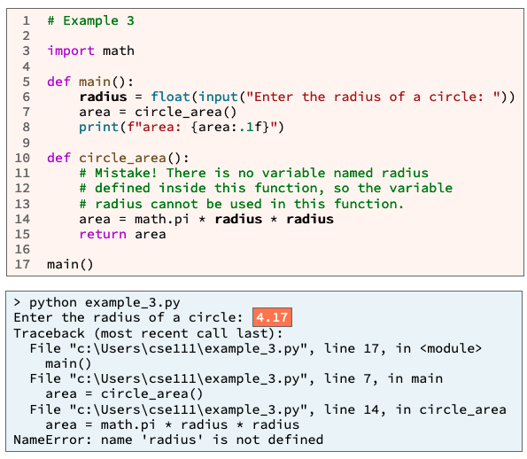
Variable Scope¶
Life of a variable (CRUD)
Common Mistakes

Slide 8
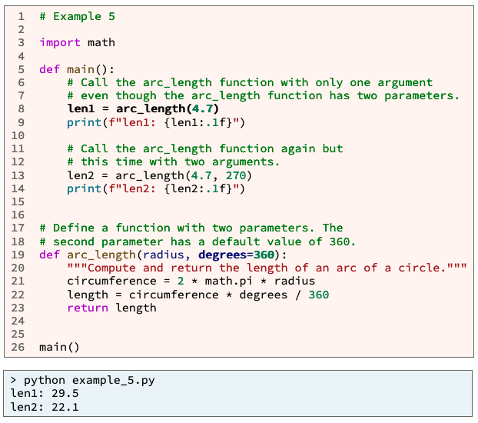
Default Parameter Values and Optional Arguments¶
Python allows function parameters to have default values.
If a parameter has a default value, then its corresponding argument is optional.
If a function is called without an argument, the corresponding parameter gets its default value.

Slide 9
Function Design¶
Understandable by other programmers
performs a single task
relatively short, perhaps fewer than 20 lines of code
few decision points (branches and loops)
As reusable as possible
Input (return)
Process (branches and loops)
Output (parameters)

Slide 10
Summary
Declaring
Calling
Scope: CRUD
Default Parameters
Keep it simple
def function_name(param1, param2, … paramN):
"""documentation string"""
statement1
statement2
⋮
statementN
return value
variable_name = function_name(arg1, arg2, … argN)
def arc_length(radius, degrees=360):
length = arc_length(3.5)

Slide 11
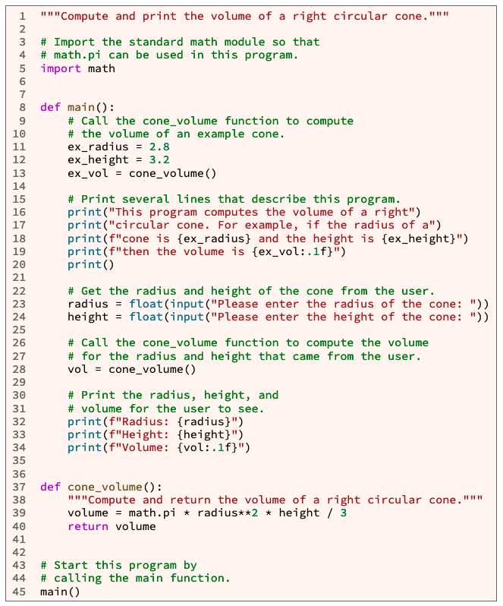
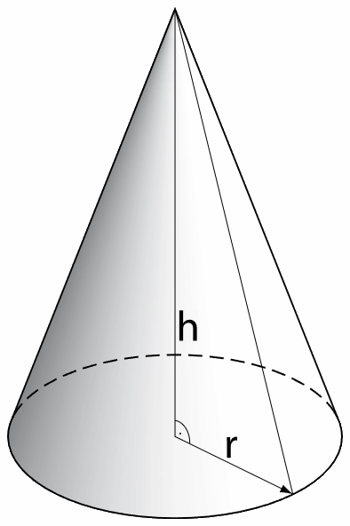
Checkpoint 04 Checkpoint: Variable Scope
Purpose
Problem Statement¶
Check your understanding of parameters, arguments, and local variable scope by fixing a program that won't run because the programmer tried to use variables that were defined in a different function.
Cone_volume(wradius, height)
https://byui-cse.github.io/cse111-course/lesson04/check.html

Slide 12
Checkpoint 04 Checkpoint: Variable Scope

Slide 13
Checkpoint 04 Checkpoint: Variable Scope
Do the following:
Using VS Code, open a new file. Copy and paste all of the example program above into the new file. Save the new file as cone_volume.py
Run your cone_volume.py program. What error message do you see in the terminal frame?
Fix the cone_volume function which begins on line 37 by adding two parameters to its header. What parameter names should you use? Hint: the parameter names at line 37 and the variable names at line 39 must be the same.
Fix the call to the cone_volume function that is in main at line 13 by adding two arguments.
Because the cone_volume function has two parameters (you added the two parameters in the previous step), each call to the cone_volume function must have two arguments.
What variable names should you use for the arguments? Hint: the only variables that you can use must be defined inside main above line 13.
Fix the call to the cone_volume function that is in main at line 28 by adding two arguments.
What variable names should you use for the arguments? Hint: the only variables that you can use must be defined inside main above line 28.
Save your program and run it again.
Did it run correctly? If not, fix the mistakes until it runs correctly.
https://byui-cse.github.io/cse111-course/lesson04/check.html

Slide 14
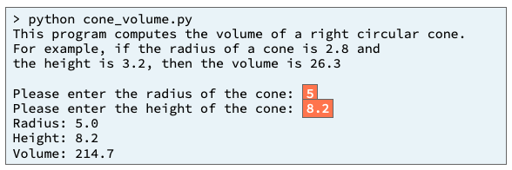
Checkpoint 04 Checkpoint: Variable Scope
Testing Procedure/Verify¶
Verify that your program works correctly by following each step in this testing procedure:
After you finish the steps of this assignmnet, run your program and enter the inputs shown below. Ensure that your program's output matches the output below.
Quality Assurance: Validate:
Which of the following did you complete?
Copy and paste the program into a file named cone_volume.py
Fix the cone_volume function by adding parameters to its header.
In the main function, fix both calls to the cone_volume function by adding arguments.
Run your program and verify that it prints the same output as shown in the Sample Run section of the assignment.
Compare your program to the sample program.
https://byui-cse.github.io/cse111-course/lesson04/check.html

Slide 15
Prove: Assignment
https://byui-cse.github.io/cse111-course/lesson04/teach.html

Slide 16
L03 Prove: Milestone 03 Prove Milestone: Writing Functions
Purpose¶
Problem Statement¶
Prove that you can write functions with parameters and call those functions multiple times with arguments.
Modern computers are capable of performing all sorts of calculations to produce numbers.
However, they are also capable of performing calculations to produce art, illustrations, animations, movies, and music.
https://byui-cse.github.io/cse111-course/lesson04/prove.html

Slide 17
04 Team Activity: Writing Functions

Slide 18
04 Team Activity: Writing Functions
Purpose
Strengthen your understanding of user-defined functions, parameters, arguments, and local variable scope by writing a program that has three or more functions.

Slide 19
04 Team Activity: Writing Functions
Purpose¶
Problem Statement¶
Strengthen your understanding of user-defined functions, parameters, arguments, and local variable scope by writing a program that has three or more functions.
In many countries, food is stored in steel cans (also known as tin cans) that are shaped like cylinders. There are many different sizes of steel cans.
The storage efficiency of a can tells us how much a can stores versus how much steel is required to make the can.
Some sizes of cans require a lot of steel to store a small amount of food.
Other sizes of cans require less steel and store more food.
A can size with a large storage efficiency is considered more friendly to the environment than a can size with a small storage efficiency.
https://byui-cse.github.io/cse111-course/lesson04/teach.html

Slide 20

04 Team Activity: Writing Functions
Problem Statement (cont)
The storage efficiency of a steel can is computed by dividing the volume of a can by its surface area.
In other words, the storage efficiency of a can is the space inside the can divided by the amount of steel required to make the can. The formulas for the volume and surface area of a cylinder are:
volume = π radius² height
surface_area = 2π radius (radius + height)
Where:
π is the constant PI, the ratio of the circumference of a circle divided by its diameter (use math.pi)
radius is the radius of the cylinder
height is the height of the cylinder
https://byui-cse.github.io/cse111-course/lesson04/teach.html

Slide 21
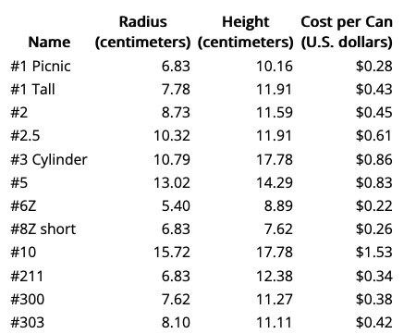
04 Team Activity: Writing Functions
Assignment¶
Work as a team to write a Python program named can_sizes.py that computes and prints the storage efficiency for each of the following 12 steel can sizes. Then visually examine the output and answer this question, "Which can size has the highest storage efficiency?"
https://byui-cse.github.io/cse111-course/lesson04/teach.html

Slide 22
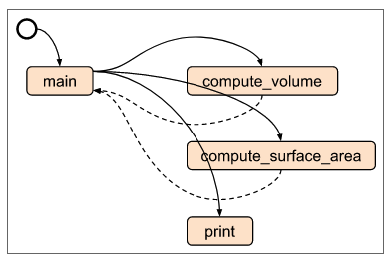
04 Team Activity: Writing Functions
If you separate your program into functions, this problem will be much easier to solve than if you don't separate it into functions. You are free to write any functions that you choose in your program, but we strongly suggest that your program include at least these three functions:
main
compute_volume
compute_surface_area
https://byui-cse.github.io/cse111-course/lesson04/teach.html

Slide 23
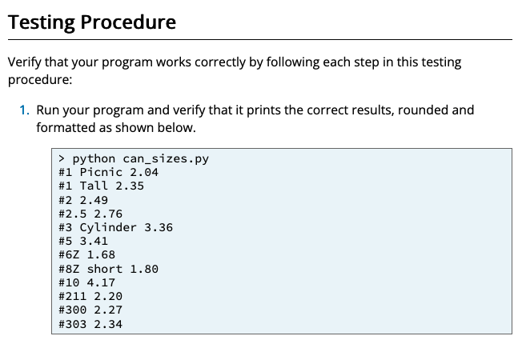
04 Team Activity: Writing Functions

Slide 24
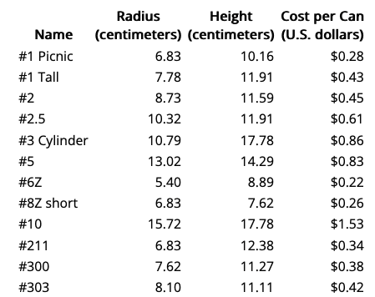
04 Team Activity: Writing Functions
Input
Process
Output
main

Slide 25
04 Team Activity: Writing Functions
Input
Process
Output
main
Name
Radius
Height
CostperCan

Slide 26
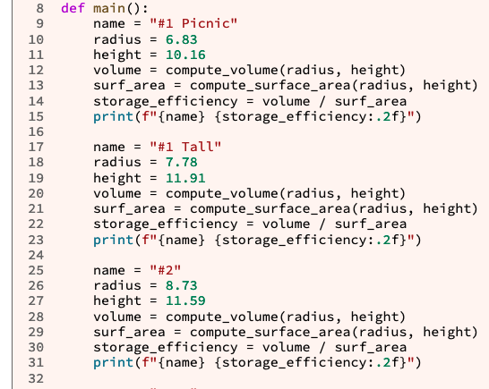
Example of what that looks like?
def get_cans():
cans = [
[“#1 Picnic”, 6.83, 10.16],
[“#1 Tall”, 7.78, 11.91]
…
return cans
def main():
cans = get_cans()
for each can in cans
name = can[0]
radius = can[1]
height = can[2]
volume= compute_volume(radius, height)
surface_area = compute_surface_area(radius, height)
storage_effiency = volume/surface_area
print(name, storage_effiency)
Cans = [
[“#1 Picnic”, 6.83, 10.16],
[“#1 Tall”, 7.78, 11.91]
…
Name
for can in cans:
name = can[0]
radius = can[1]
height = can[2]
volume = compute_volume(radius, height)
surf_area = compute_surface_area(radius, height)
storage_efficiency = volume / surf_area
print(f"{name} {storage_efficiency:.2f}")
Radius
Height
CostperCan

Slide 27

04 Team Activity: Writing Functions
Input
Process
Output
main
print()
get_table()
Row
Row 0: [Col:0, Col:1, Col:2, …]
Row 1: [Name, Radius, Height, Cost]
Row 2: [#2, 8.73, 11.59, 0.45]
birth_str
birth_str
Compute_volume
Compute_surface_area
volume
area
volume = π radius² height
surface_area = 2π radius (radius + height)

Slide 28
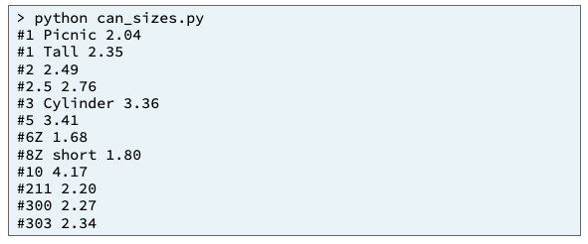
04 Team Activity: Writing Functions
Input
Process
Output
main
print()
get_table()
Row
Row 0: [Col:0, Col:1, Col:2, …]
Row 1: [Name, Radius, Height, Cost]
Row 2: [#2, 8.73, 11.59, 0.45]
birth_str
birth_str
Compute_volume
Compute_surface_area
volume
area
volume = π radius² height
surface_area = 2π radius (radius + height)

Slide 29
04 Team Activity: Writing Functions
Input
Process
Output
main
print()
get_table()
cans
Name
Radius
Height
volume
Storage_effiency
CostperCan
Surface_area
radius
radius
height
height
Compute_volume
Compute_surface_area
scope
volume
area
scope
volume = π radius² height
surface_area = 2π radius (radius + height)

Slide 30
04 Team Activity: Writing Functions
Input
Process
Output
main
print()
get_table()
def get_cans():
cans = [
[“#1 Picnic”, 6.83, 10.16],
[“#1 Tall”, 7.78, 11.91]
…
return cans
def main():
cans = get_cans()
for each can in cans
name = can[0]
radius = can[1]
height = can[2]
volume= compute_volume(radius, height)
surface_area = compute_surface_area(radius, height)
storage_effiency = volume/surface_area
print(name, storage_effiency)
cans
Name
Radius
Height
volume
Storage_effiency
CostperCan
Surface_area
radius
radius
height
height
Compute_volume
Compute_surface_area
scope
volume
area
scope
volume = π radius² height
surface_area = 2π radius (radius + height)

Slide 31
04 Team Activity: Writing Functions
Core Requirements¶
Stretch Challenges¶
Your program must compute the volume of all 12 can sizes.
Your program must compute the surface area of all 12 can sizes.
Your program must compute and print the storage efficiency of all 12 can sizes.
Add another function named compute_storage_efficiency to your program.
This function should call the compute_volume and compute_surface_area functions and then compute and return the storage efficiency of a steel can size.
Replace code in the main function with a call to the compute_storage_efficiency function as appropriate. Did adding and calling the compute_storage_efficiency function reduce the number of lines of code in your program?
The table of can sizes that appears in the Assignment section above includes a column that contains the cost per can of each steel can size. Add another function to your program named compute_cost_efficiency that computes and returns the volume of a steel can divided by its cost. Write code to call the compute_cost_efficiency function and print the cost efficiency for each can size. Then visually examine the output and answer this question, "Which can size has the highest cost efficiency?"
If you remember how to use lists and a for loop from CSE 110, rewrite your main function so that it uses a list or lists that contain the can size names and dimensions. Then write a loop that processes the values in the list.
Add if statements inside the loop to automatically determine which can size has the best storage efficiency and which can size has the best cost efficiency.
volume
Surface_area
compute_storage_efficiency
scope
?
?_area
compute_cost_efficiency

Slide 32
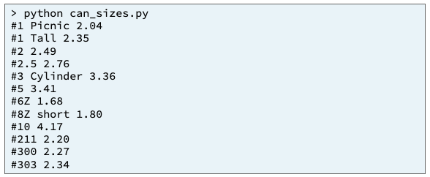
04 Team Activity: Writing Functions
Testing Procedure /Verify¶
Quality Assurance/Validation Quiz
Verify that your program works correctly by following each step in this testing procedure:
Run your program and verify that it prints the correct results, rounded and formatted as shown below.
Prior to starting the activity, I prepared myself by completing all of the required preparation material.
I arrived at the designated time for our meeting and met with my teammates.
I actively worked with my teammates for the duration of the activity.
Mark all of the core requirements that you completed.
I thoughtfully compared my solution to the sample solution and noted any differences.
https://byui-cse.github.io/cse111-course/lesson04/teach.html

Slide 33
06 Prove Assignment: Troubleshooting Functions
https://byui-cse.github.io/cse111-course/lesson06/prove.html

Slide 34
06 Prove Assignment: Troubleshooting Functions
Purpose
Prove that you can write a Python program and write and run test functions to help you find and fix mistakes.
https://byui-cse.github.io/cse111-course/lesson06/prove.html

Slide 35
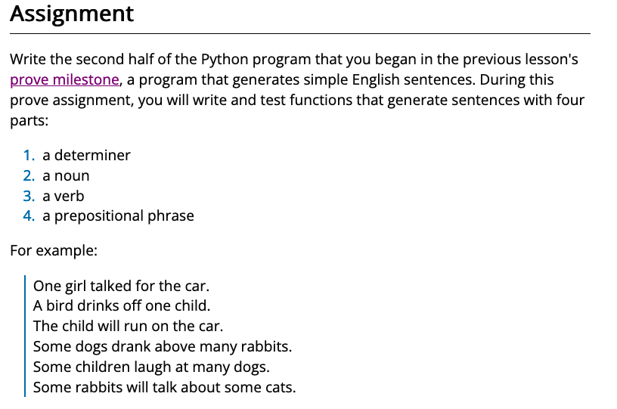
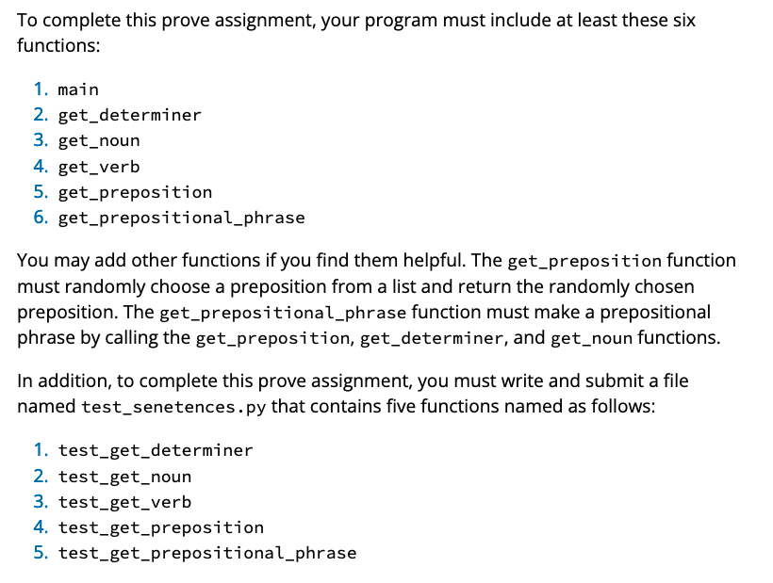
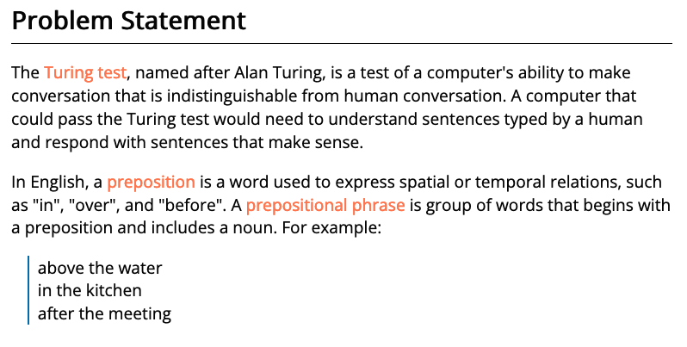
06 Prove Assignment: Troubleshooting Functions
Purpose
Prove that you can write a Python program and write and run test functions to help you find and fix mistakes.
https://byui-cse.github.io/cse111-course/lesson06/prove.html

Slide 36
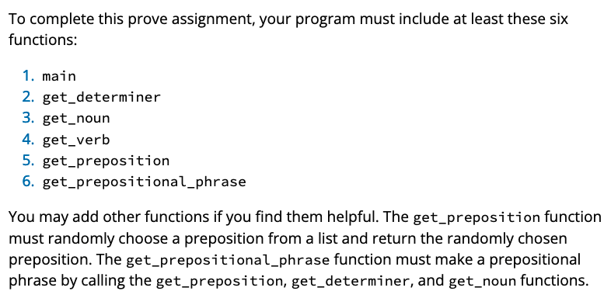
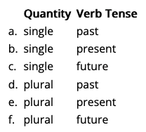
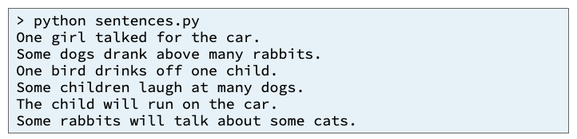
Input
Process
Output
main
quantity
quantity
quantity
birth_str
tense
get_determiner()
get_noun()
get_verb()
get_sentence()
quantity
get_preposition()
get_preposition_phrase()
https://byui-cse.github.io/cse111-course/lesson06/prove.html

Slide 37
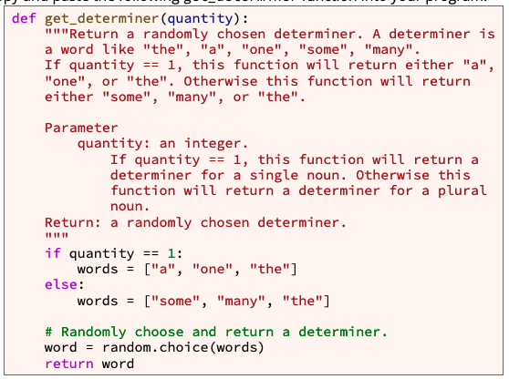
def get_determiner(quantity):
If quantity == 1
words = ["a", "one", "the"]
words = ["some", "many", "the"]
word = random.choice(words)
return word
https://byui-cse.github.io/cse111-course/lesson06/prove.html

Slide 38
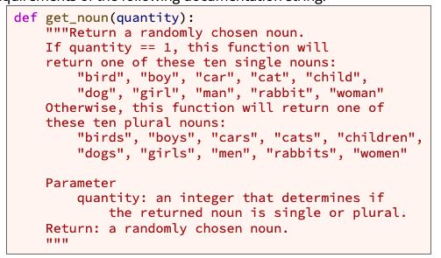
def get_noun(quantity):
If quantity == 1
words = ["bird", "boy", "car", "cat", "child", "dog", "girl", "man", "rabbit", "woman”]
words = ["birds", "boys", "cars", "cats", "children", "dogs", "girls", "men", "rabbits", "women”]
word = random.choice(words)
return word
https://byui-cse.github.io/cse111-course/lesson06/prove.html

Slide 39
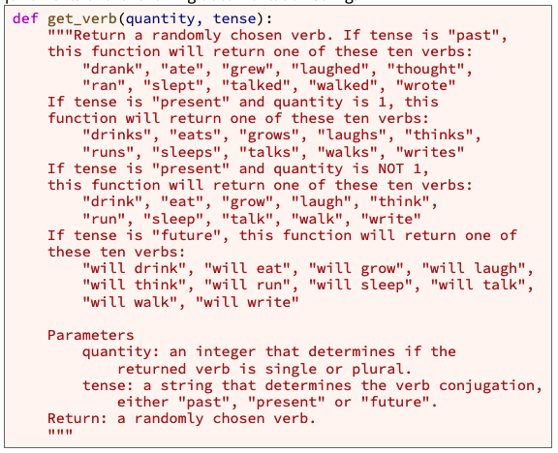
def get_verb(quantity, tense):
If tense == past
words = ["drank", "ate", "grew", "laughed", "thought", "ran", "slept", "talked", "walked", "wrote”]
If tense == future
words = ["will drink", "will eat", "will grow", "will laugh", "will think", "will run", "will sleep", "will talk", "will walk", "will write”]
If tense == present
words = ["drinks", "eats", "grows", "laughs", "thinks", "runs", "sleeps", "talks", "walks", "writes”]
If quantity == 1
Else #If quantity >1
words = ["drink", "eat", "grow", "laugh", "think", "run", "sleep", "talk", "walk", "write”]
word = random.choice(words)
return word
https://byui-cse.github.io/cse111-course/lesson06/prove.html

Slide 40
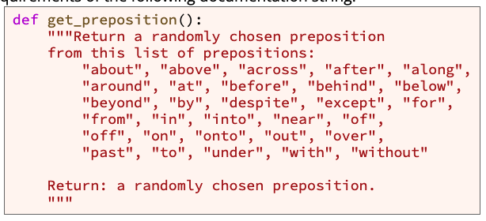
def get_preposition():
https://byui-cse.github.io/cse111-course/lesson06/prove.html

Slide 41
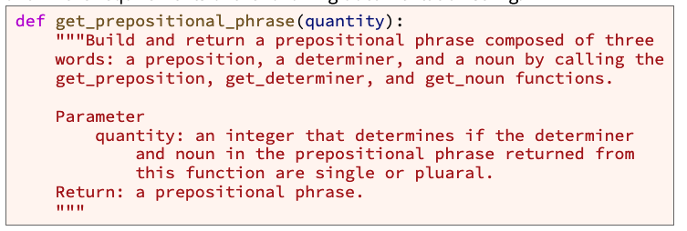
def get_prepositional_phrase(quantity):
https://byui-cse.github.io/cse111-course/lesson06/prove.html

Slide 42
def get_sentence(quantity, tense):
Remember
Determiner = get_determiner(quantity)
noun = get_noun(quantity)
verb = get_verb(quantity, tense)
Sentence = determiner +” “ + noun + “ “ + verb
return sentence
get_sentence()
determiner
sentence
noun
+
https://byui-cse.github.io/cse111-course/lesson06/prove.html
verb

Slide 43
def get_prepositional_phrase(quantity):
preposition = get_preposition()
get_prepositionalphrase()
determiner = get_determiner(quantity)
preposition
sentence
determiner
+
noun = get_noun(quantity)
noun
Prepostion_phrase = preposition +” “ + determiner + “ “ + noun
return sentence
https://byui-cse.github.io/cse111-course/lesson06/prove.html

Slide 44
def get_sentence(quantity, tense):updated
Determiner = get_determiner(quantity)
get_sentence()
noun = get_noun(quantity)
determiner
sentence
noun
+
verb = get_verb(quantity, tense)
verb
Sentence = determiner +” “ + noun + “ “ + verb
phase
return sentence
phrase = get_prepositional_phrase(quantity)
Sentence = determiner +” “ + noun + “ “ + verb + ” “ + phrase
return sentence
https://byui-cse.github.io/cse111-course/lesson06/prove.html

Slide 45
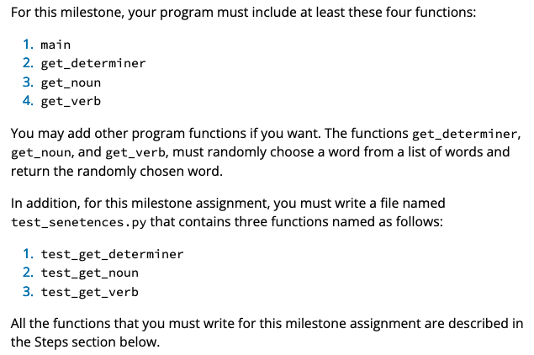
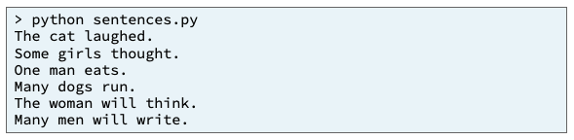
Input
Process
Output
main
quantity
quantity
quantity
birth_str
tense
get_determiner()
get_noun()
get_verb()
get_sentence()
quantity
get_preposition()
get_preposition_phrase()
https://byui-cse.github.io/cse111-course/lesson06/prove.html

Slide 46
Input
Process
Output
determiner
sentence
main
noun
+
verb
quantity
phrase
tense
quantity
quantity
birth_str
get_determiner()
get_noun()
get_verb()
quantity
get_preposition()
get_preposition_phrase()
https://byui-cse.github.io/cse111-course/lesson06/prove.html

Slide 47
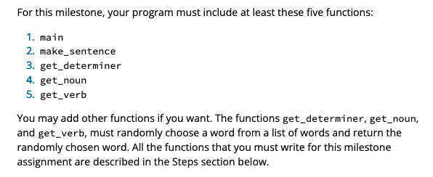
Input
Process
Output
sentence
main
QuantityList = [“single”, “plural”]
Or Quantity = [1,2]
TenseList = [“past”, ”present”, ”future”]
quantity
For Quantity in QuanityList
tense
For Tense in TenseList
quantity
quantity
quantity
quantity
tense
tense
get_determiner()
get_noun()
get_verb()
get_sentence()
determiner
sentence
quantity
noun
+
get_preposition()
get_preposition_phrase()
verb
https://byui-cse.github.io/cse111-course/lesson06/prove.html
phase

Slide 48
Input
Process
Output
sentence
main
QuantityList = [“single”, “plural”]
Or Quantity = [1,2]
Print_sentence()
TenseList = [“past”, ”present”, ”future”]
quantity
For Quantity in QuanityList
tense
For Tense in TenseList
quantity
quantity
quantity
quantity
tense
tense
get_determiner()
get_noun()
get_verb()
get_sentence()
determiner
sentence
quantity
noun
+
get_preposition()
get_preposition_phrase()
verb
https://byui-cse.github.io/cse111-course/lesson06/prove.html
phase

Slide 49
Input
Process
Output
get_test_data()
sentence
main
QuantityList = [“single”, “plural”]
Or Quantity = [1,2]
QuantityList = [single, plural]
TenseList = [“past”, “present”, “future”]
for quantity in quantityList:
for tense in tenseList:
test_data = [quantity, tense]
return test_data
test _data
Print_sentence()
QUANTITY = 0
TENSE = 1
Test_data = get_test_data()
For data in test_data:
quantity = data[QUANTITY]
tense = data [TENSE]
sentence = get_sentence(quantity, tense)
display_sentence(sentenece)
quantity
tense
quantity
quantity
quantity
quantity
tense
tense
get_determiner()
get_noun()
get_verb()
get_sentence()
determiner
sentence
quantity
noun
+
get_preposition()
get_preposition_phrase()
verb
https://byui-cse.github.io/cse111-course/lesson06/prove.html
phase

